Slide 1

THYNK UNLIMITED
Mail Guard AI
Intelligent Spam Detection System using Machine Learning
WE LEARN FOR THE FUTURE
PRESENTED BY:
MANAS GUPTA
PRATHAMESH LAHOTI

Slide 2
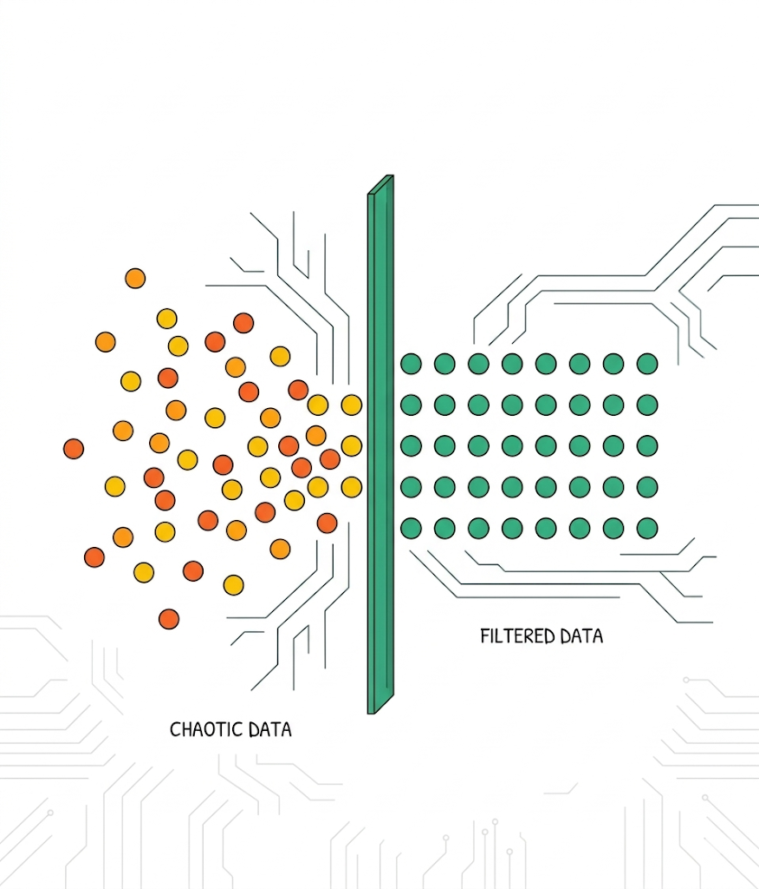
Aim: To build a robust, intelligent, and highly accurate system capable of instantly classifying emails as Spam or legitimate (Ham).
Objective 1: Maximize detection accuracy by creating a hybrid system that combines Machine Learning probabilities with strict Rule-Based keyword heuristics.
Objective 2: Provide "Explainable AI" (XAI). The user must understand exactly why a message is flagged, providing a clear Spam Score and highlighting dangerous text.

Slide 3
The Problem Statement
The Global Threat: Spam accounts for roughly 45% of all global email traffic.
Security Risks: Spam is the primary delivery method for malware, ransomware, and dangerous phishing scams.
The Productivity Drain: Businesses and individuals lose massive amounts of time manually filtering and deleting junk emails from real correspondence.
The Shortfall: Traditional filters are often "black boxes" that block real emails without explaining why to the user.
Spam is a major global issue, making up nearly 45% of all email traffic worldwide. It poses serious security risks, as many spam emails are used to distribute malware, ransomware, and phishing scams. Additionally, spam creates a productivity problem, forcing individuals and businesses to spend valuable time sorting through unwanted messages. Traditional spam filters also have a transparency problem, often acting as “black boxes” that block legitimate emails without explaining the reason to the user.

Slide 4
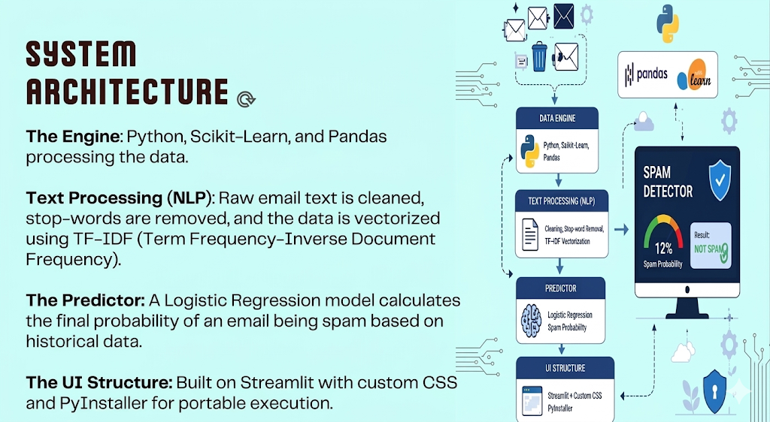
System
ArchItecture
The Engine: Python, Scikit-Learn, and Pandas processing the data.
Text Processing (NLP): Raw email text is cleaned, stop-words are removed, and the data is vectorized using TF-IDF (Term Frequency-Inverse Document Frequency).
The Predictor: A Logistic Regression model calculates the final probability of an email being spam based on historical data.
The UI Structure: Built on Streamlit with custom CSS and PyInstaller for portable execution.

Slide 5
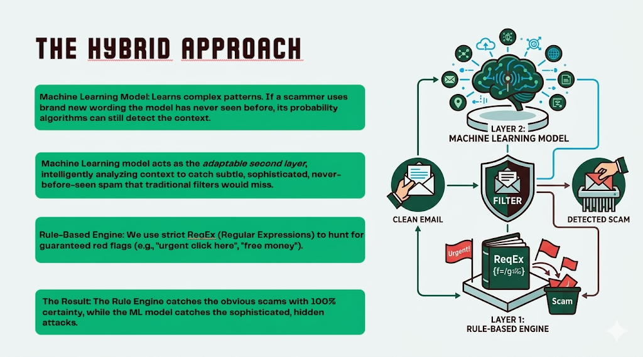
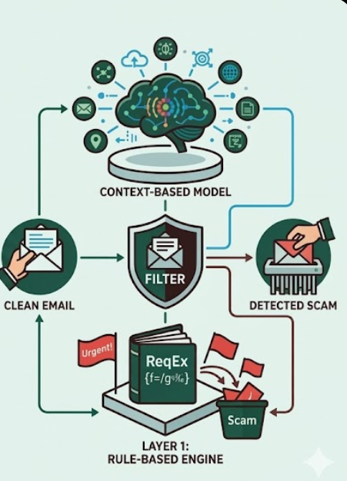
The HybrId ApproACH
Machine Learning Model: Learns complex patterns. If a scammer uses brand new wording the model has never seen before, its probability algorithms can still detect the context.
Machine Learning model acts as the adaptable second layer, intelligently analyzing context to catch subtle, sophisticated, never-before-seen spam that traditional filters would miss.
Rule-Based Engine: We use strict RegEx (Regular Expressions) to hunt for guaranteed red flags (e.g., "urgent click here", "free money").
The Result: The Rule Engine catches the obvious scams with 100% certainty, while the ML model catches the sophisticated, hidden attacks.

Slide 6
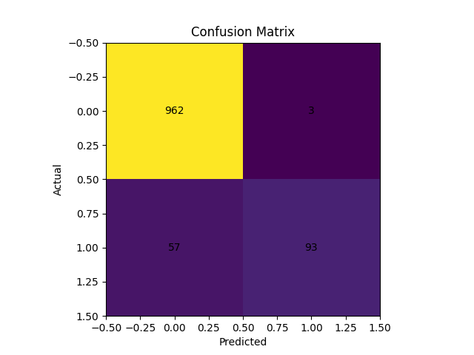
Key Features & Demo
Real-time Prediction: Instant analysis of email text simply by pasting or uploading a file.
Interactive Spam Meter: A dynamic, color-coded visual gradient bar mapping out the exact probability percentage.
Keyword Highlighting: The UI actively highlights the exact dangerous keywords it detected, proving transparent AI decision-making.
Keyword Highlighting: The UI actively highlights the exact dangerous keywords it detected, proving transparent AI decision-making.

Slide 7
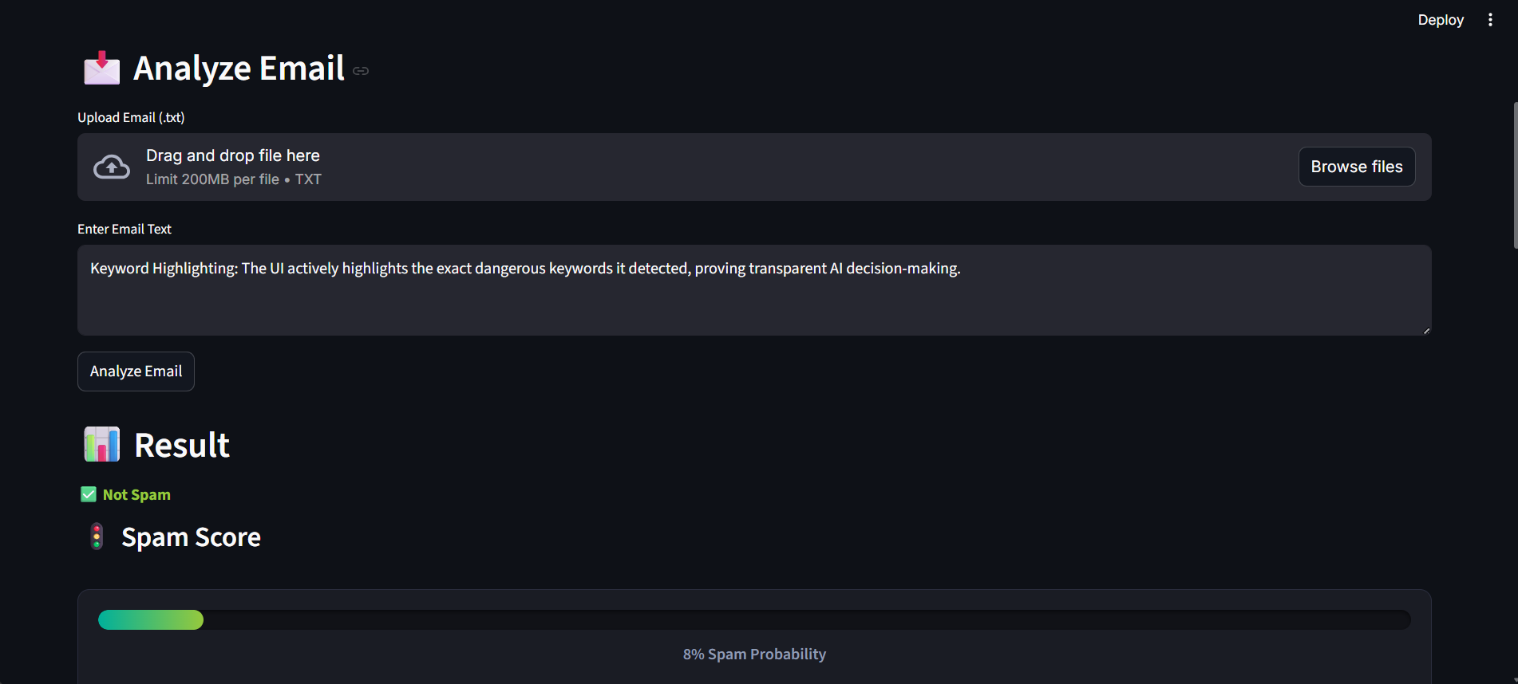
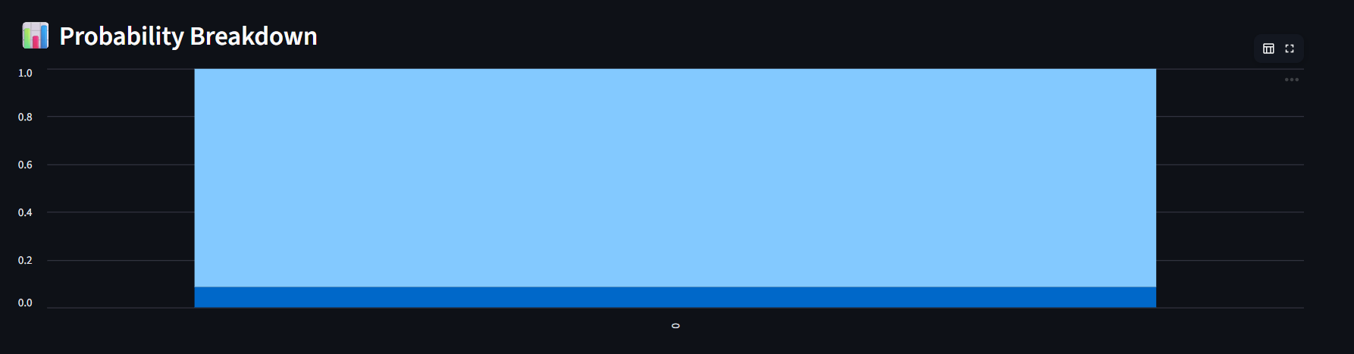

Slide 8
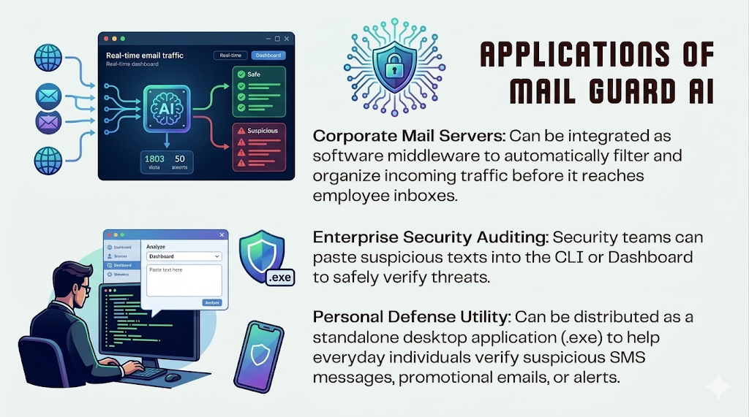
Applictaions of mail Guard AI
Corporate Mail Servers: Can be integrated as software middleware to automatically filter and organize incoming traffic before it reaches employee inboxes.
Enterprise Security Auditing: Security teams can paste suspicious texts into the CLI or Dashboard to safely verify threats. Personal Defense Utility: Can be distributed as a standalone desktop application (.exe) to help everyday individuals verify suspicious SMS messages, promotional emails, or alerts.

Slide 9
Conlusion & future scope
Conclusion:
Future Scope:
Future features:
Mail Guard AI successfully balances robust Machine Learning with strict heuristics to create a highly accurate, easy-to-understand cybersecurity tool.
Transitioning from Logistic Regression to more advanced Deep Learning models (like Transformers).
Implementing live Web/URL scanning to detect malicious links nested inside the email body.

